Slide 1

{valtools}
mariev
Software validation separate from development
for performance qualification TESTING
Marie Vendettuoli
Senior Statistical Programmer

Slide 2




Acknowledgements
Ellis Hughes
Rafael Kuttner
Kate Ostbye
Paul Stutzman
Anthony Williams
+ Pdata Team
Peyman Eshghi
Maya Gans
Eli Miller
Mike Stackhouse
Hanming Tu
+ R Package Validation Team
Notes:
This work was supported by a grant from the Bill & Melinda Gates Foundation (BMGF): The Vaccine Immunology Statistical Center (VISC) for the Collaboration for AIDS Vaccine Discovery (CAVD)

Slide 3
Defining Software Validation (for this talk)
Review: What is the R Validation Framework?
Intro to {valtools}
Why use {valtools} for performance qualification (PQ) testing?
Lessons learned at SCHARP

Slide 4






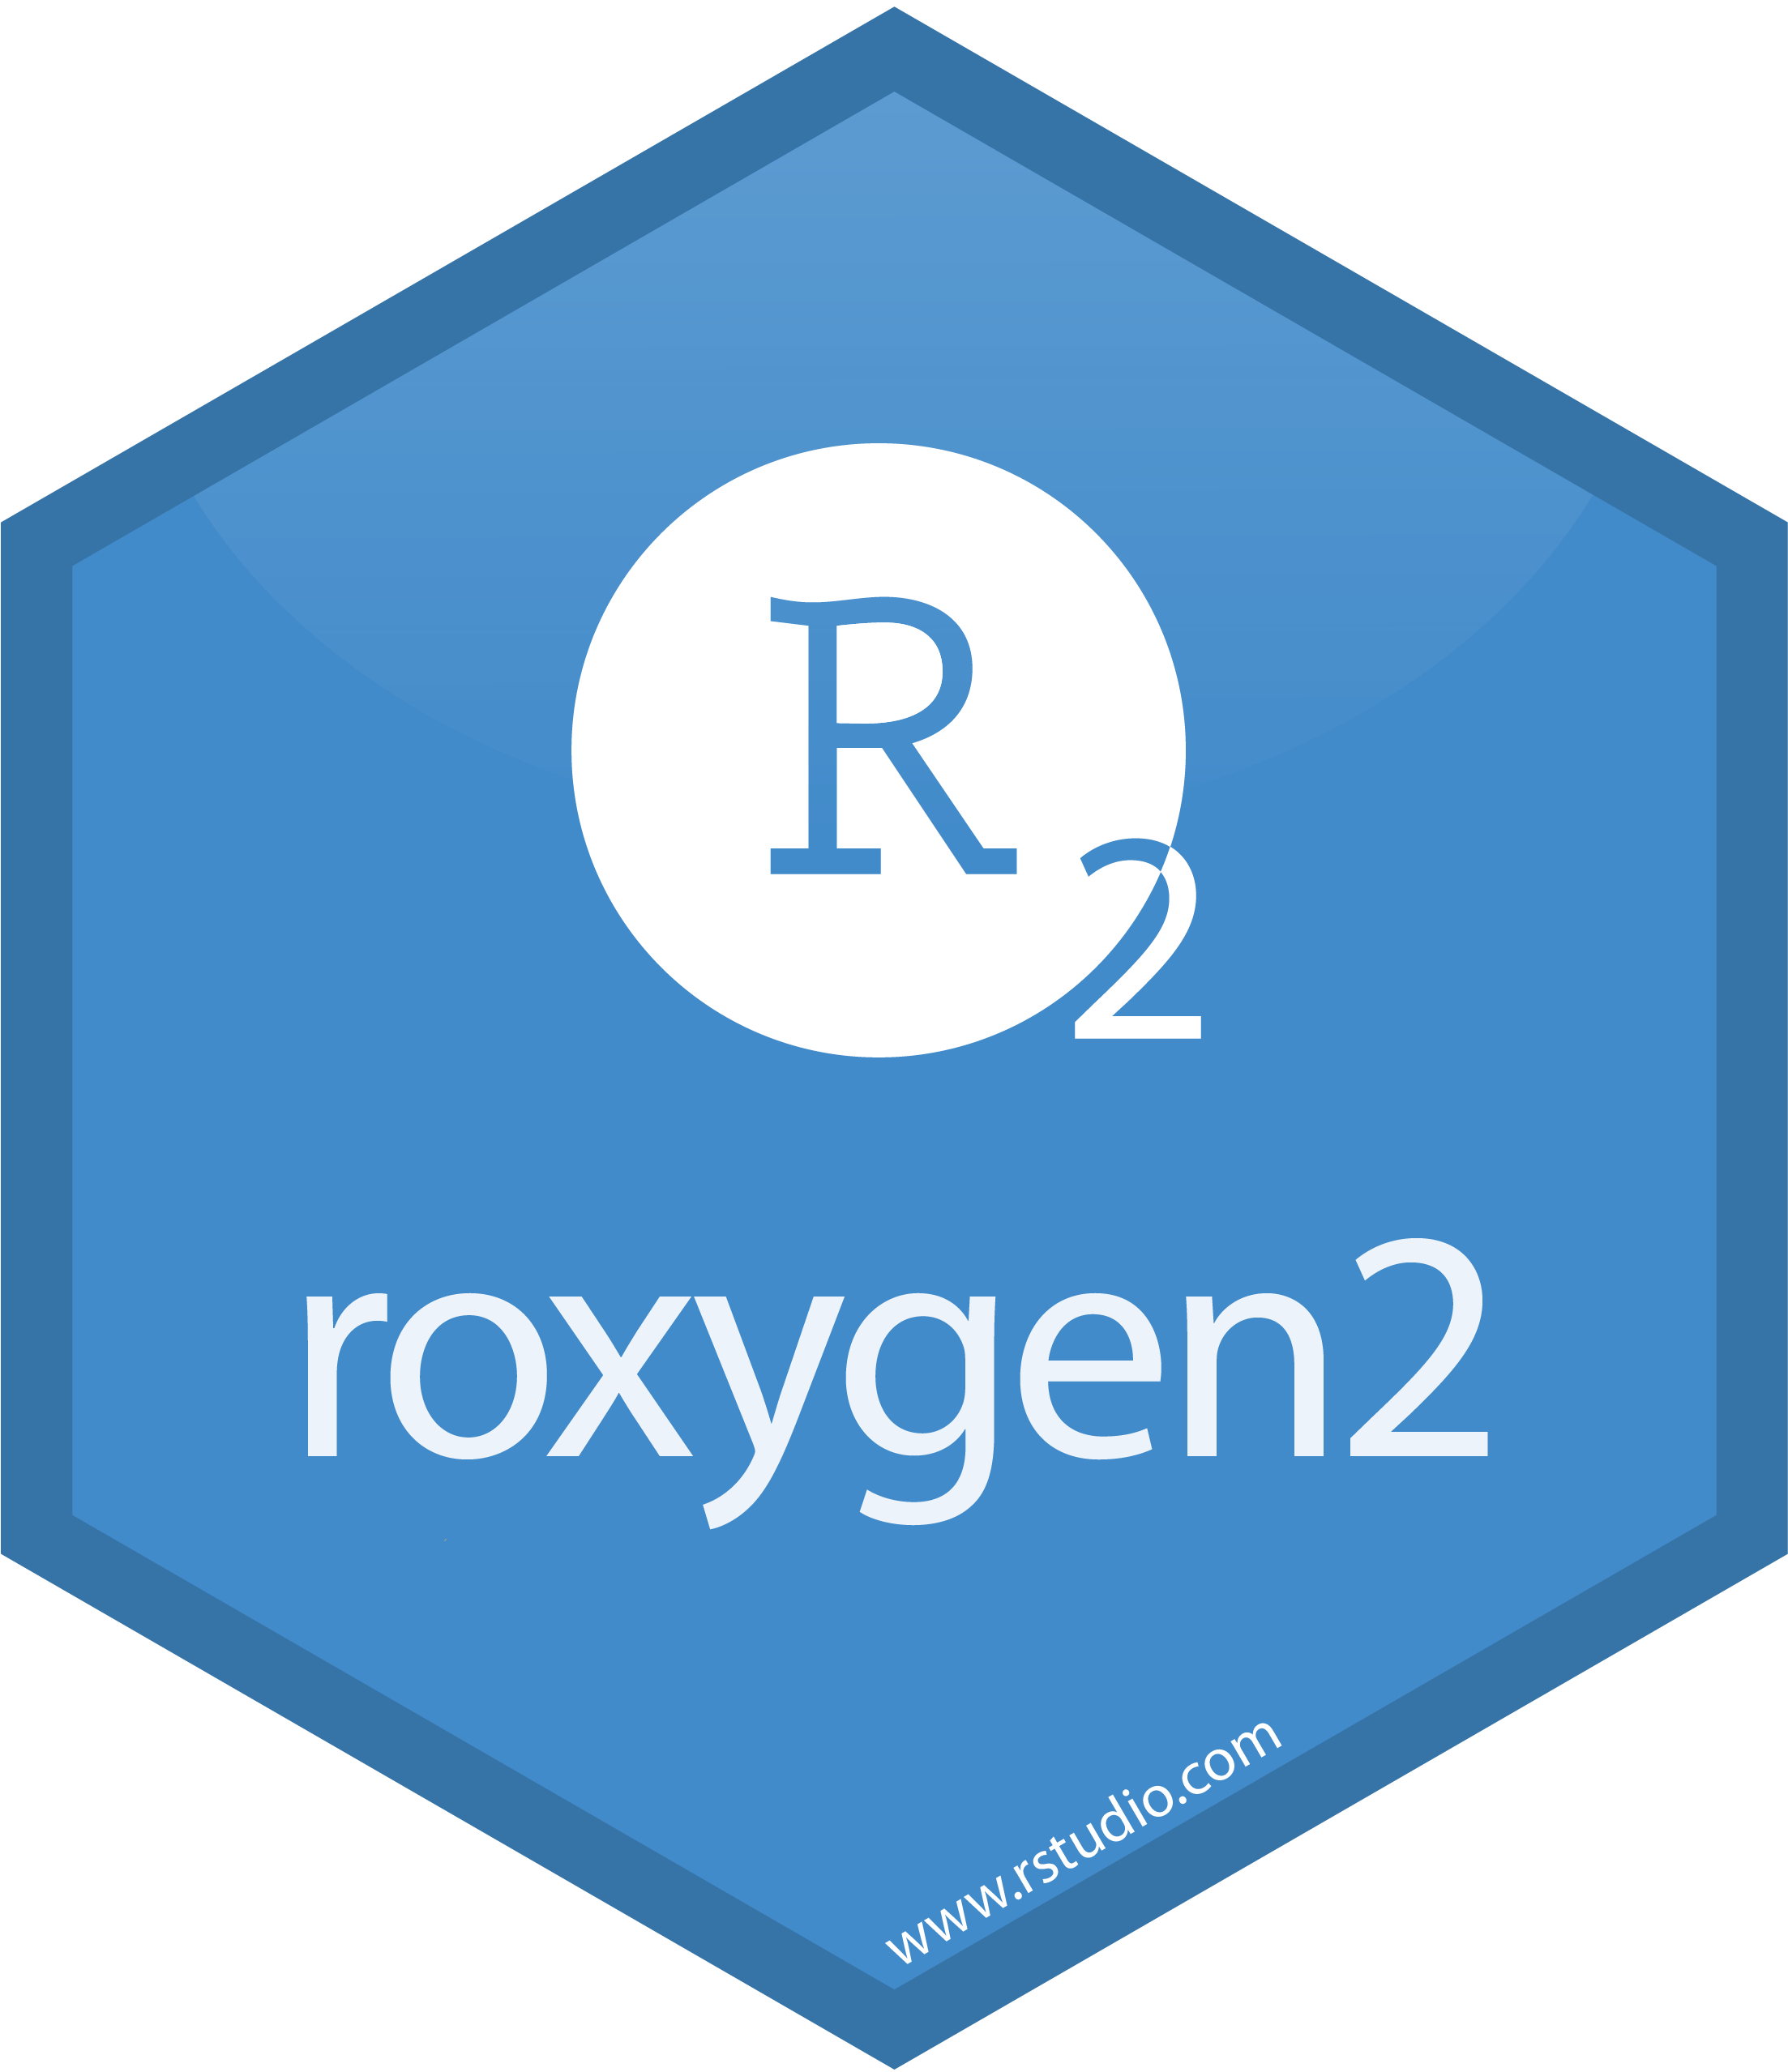
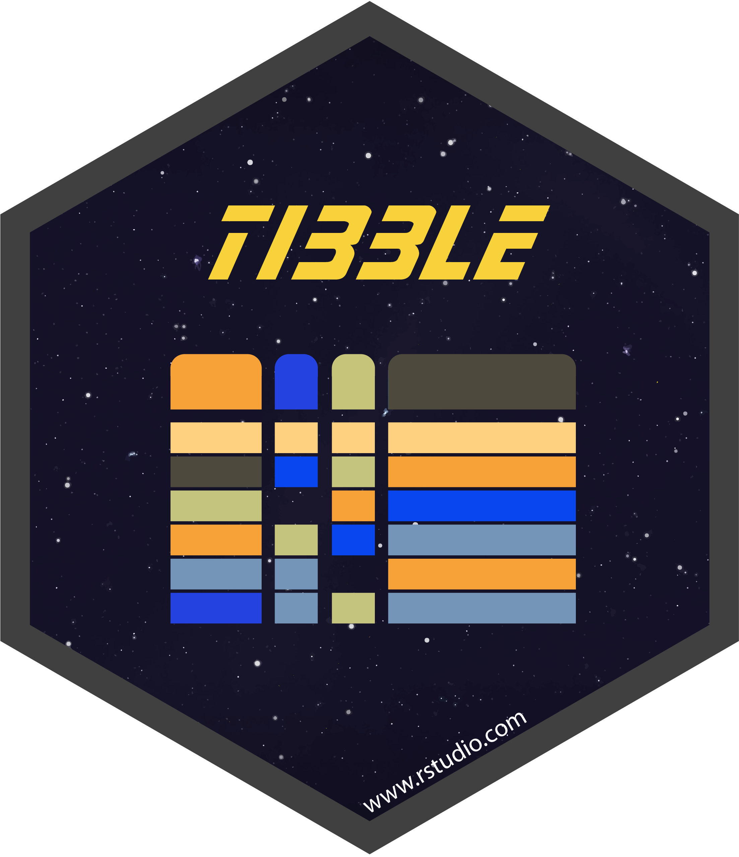


Goals of software validation
“Truth” vs “A Regulatory Requirement”
Notes:
“the act of proving that something is true or correct”
“the act of making something legally recognized”

Slide 5
Goals of software validation
Truth-seeking
How do I know this software is “fit for purpose”? Does this software play nicely with existing organizational infrastructure and resources?
Have the developers considered the edge cases that are important to me? Is this performance reproducible?
How much effort will this really take? What happens when I make an update?

Slide 6
Goals of software validation
Truth-seeking
How do I know this software is “fit for purpose”? Does this software play nicely with existing organizational infrastructure and resources?
Have the developers considered the edge cases that are important to me? Is this performance reproducible?
How much effort will this really take? What happens when I make an update?

Slide 7
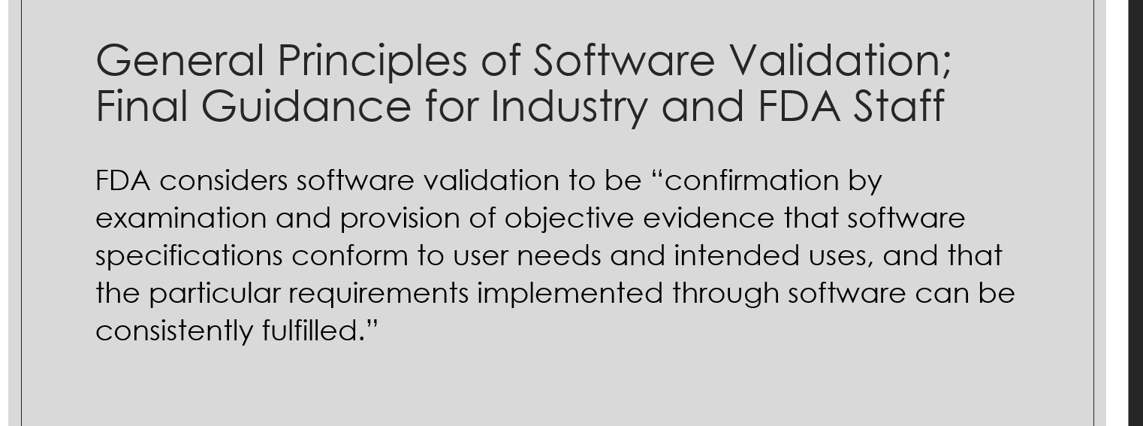
Goals of software validation
Fulfilling Regulatory Requirements
https://www.fda.gov/regulatory-information/search-fda-guidance-documents/general-principles-software-validation

Slide 8
Goals of software validation
Fulfilling Regulatory Requirements
Fit for purpose
https://www.fda.gov/regulatory-information/search-fda-guidance-documents/general-principles-software-validation

Slide 9
Goals of software validation
Fulfilling Regulatory Requirements
Reproducibility
https://www.fda.gov/regulatory-information/search-fda-guidance-documents/general-principles-software-validation

Slide 10
Goals of software validation
Fulfilling Regulatory Requirements
Effort
https://www.fda.gov/regulatory-information/search-fda-guidance-documents/general-principles-software-validation

Slide 11
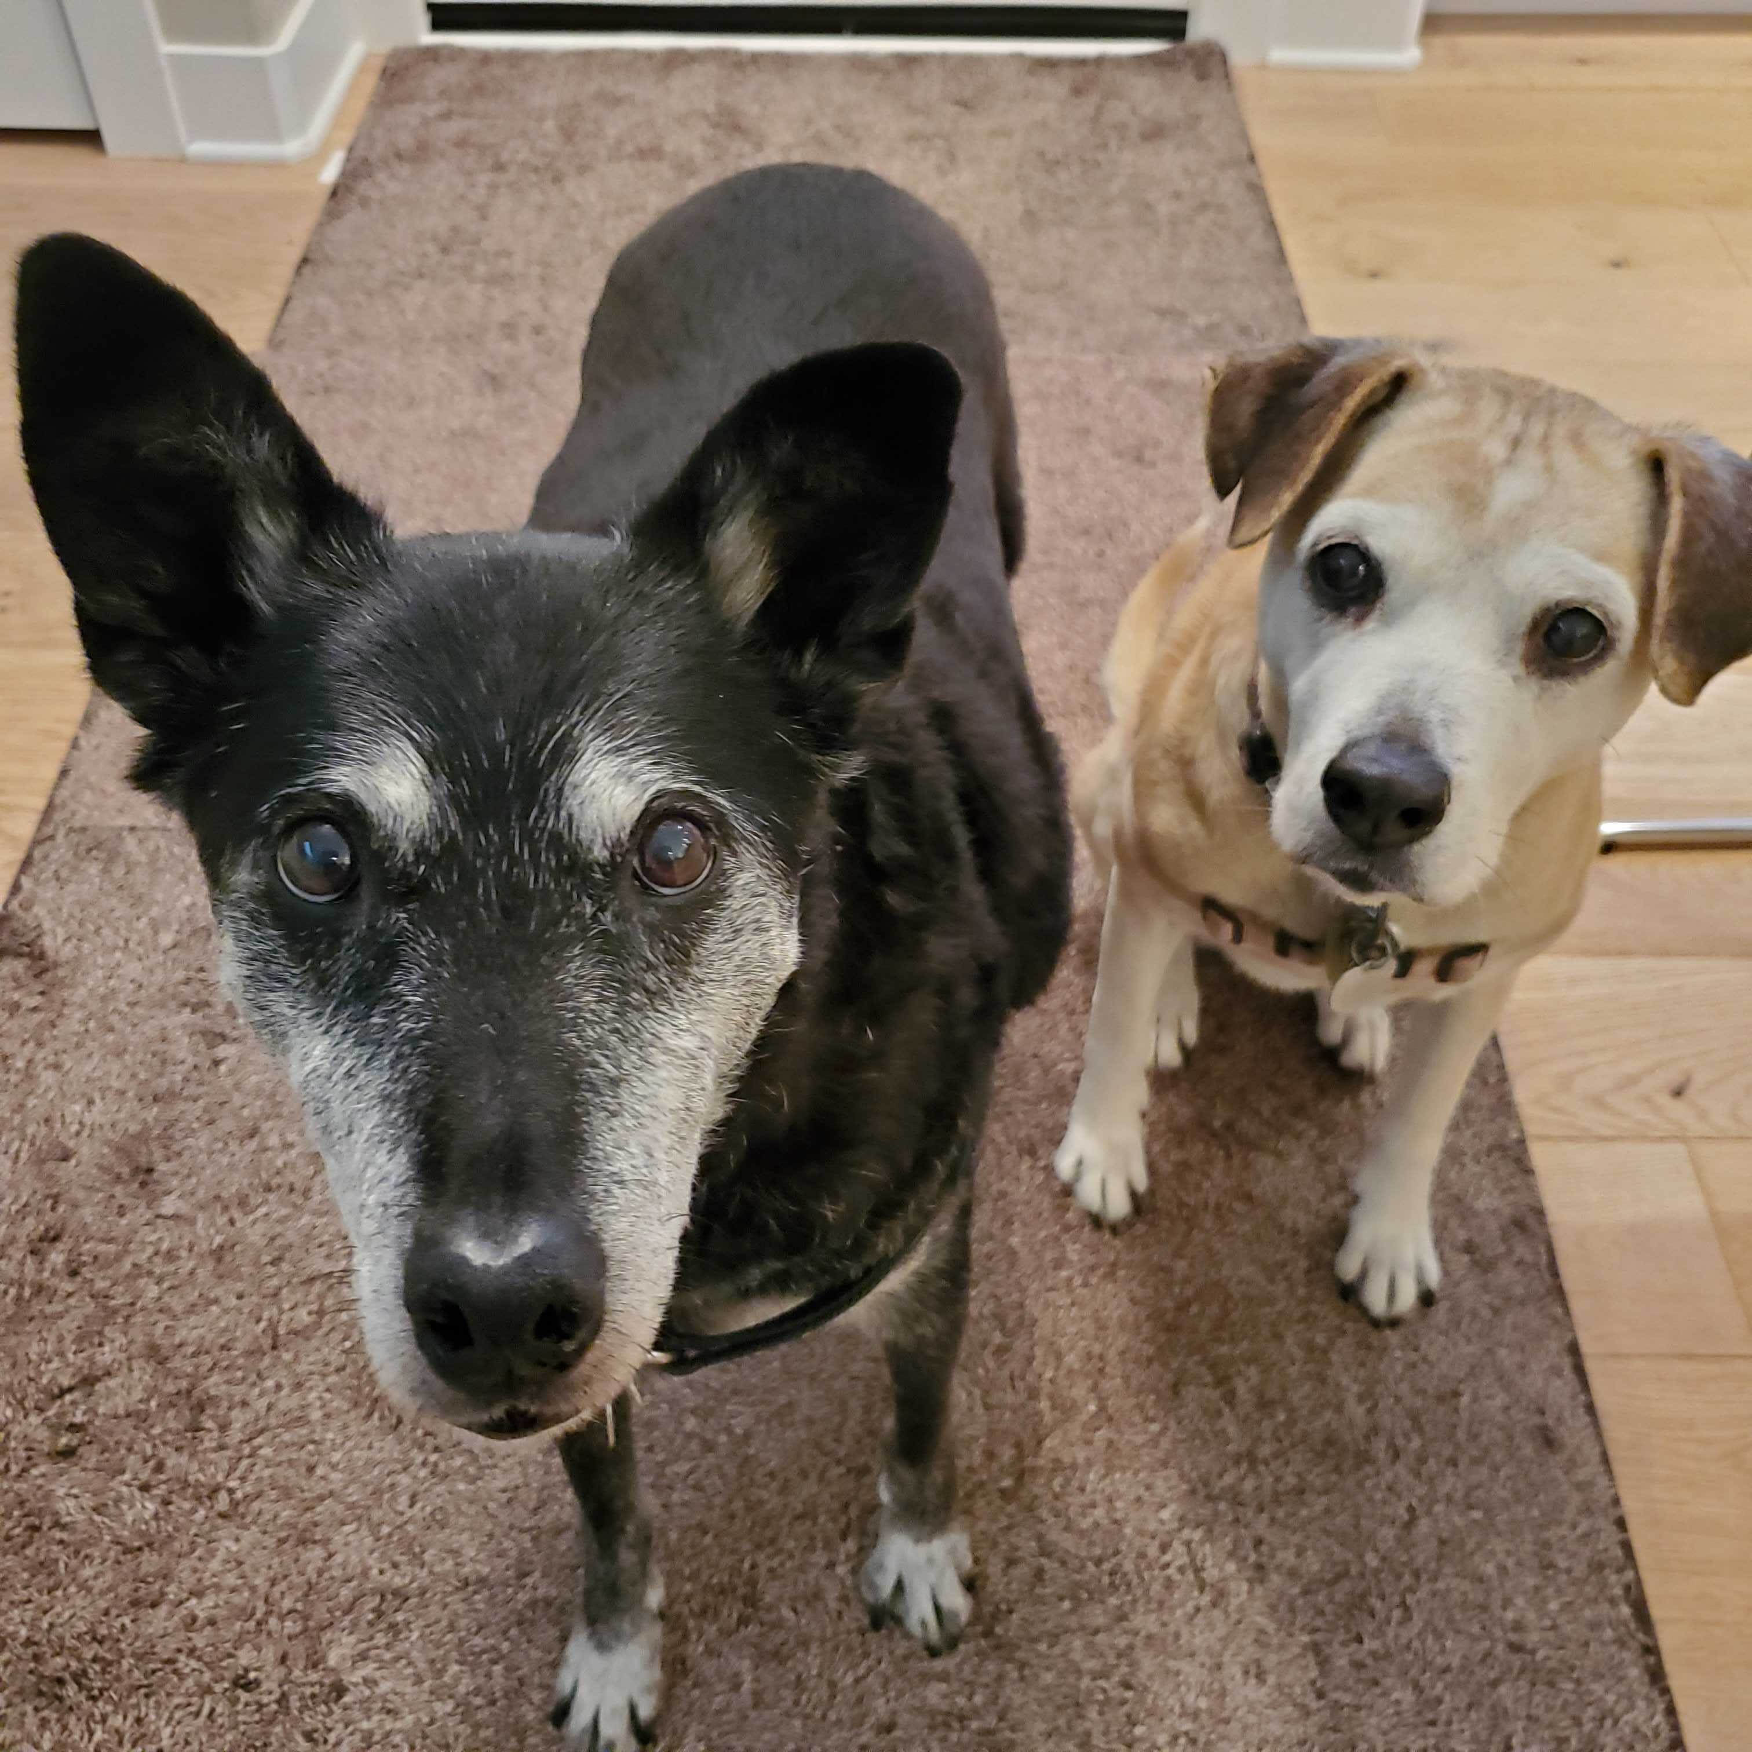
Why is this distinction important?
Example from USDA APHIS Center for Veterinary Biologics (CVB)
Estimating relative potency in vaccines
Notes:
United states department of agriculture (usda) animal and plant health inspection service (aphis) is the regulatory agency charged with upholding Virus Serum Toxin Act (vsta) of 1913, which is a set of regulations intended to preserve safe and effective supply of animal vaccines

Slide 12
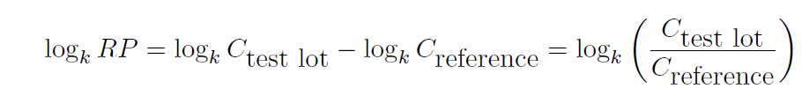
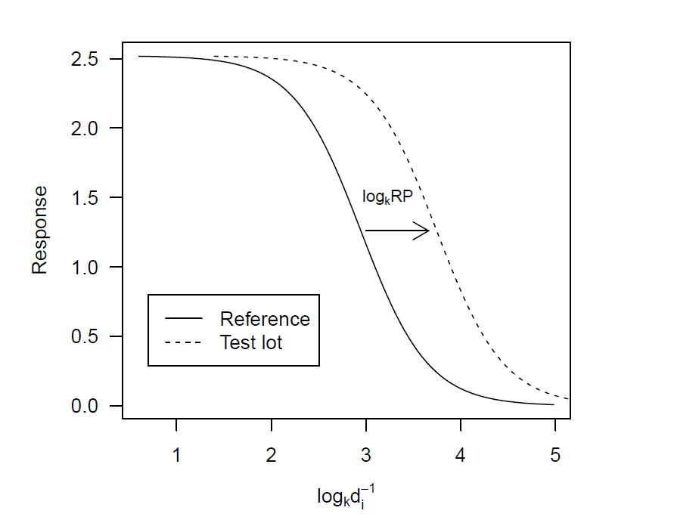
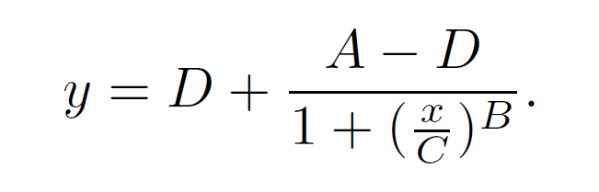
Relative Potency – An estimate of performance difference between lots
Siev D. Interpretation and estimation of relative potency in vaccines. J Immunol Methods. 1997 Oct 27;208(2):131-9. doi: 10.1016/s0022-1759(97)00134-8. PMID: 9433468.
Tong, C. and Vendettuoli, M. (2017) USDA APHIS STATWI0005.01 - Logistic Curve Parameterizations in Commercial Software. https://www.aphis.usda.gov/animal_health/vet_biologics/publications/STATWI0005.pdf
Notes:
X-axis: serial dilution (may be expressed in concentration)
Y-axis: ELISA OD
Solid line: reference lot
Dotted line: new manufacture lot

Slide 13
Lower asymptote
Theoretically should be zero!!
Upper asymptote
Response
ELISA OD
Scale factor
Sign = direction of pseudo-linear region
Serial dilution
Location parameter
Siev D. Interpretation and estimation of relative potency in vaccines. J Immunol Methods. 1997 Oct 27;208(2):131-9. doi: 10.1016/s0022-1759(97)00134-8. PMID: 9433468.
Tong, C. and Vendettuoli, M. (2017) USDA APHIS STATWI0005.01 - Logistic Curve Parameterizations in Commercial Software. https://www.aphis.usda.gov/animal_health/vet_biologics/publications/STATWI0005.pdf
Notes:
X-axis: serial dilution (may be expressed in concentration)
Y-axis: ELISA OD
Solid line: reference lot
Dotted line: new manufacture lot

Slide 14
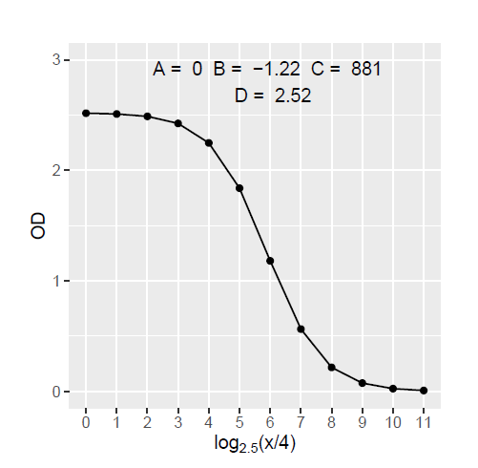
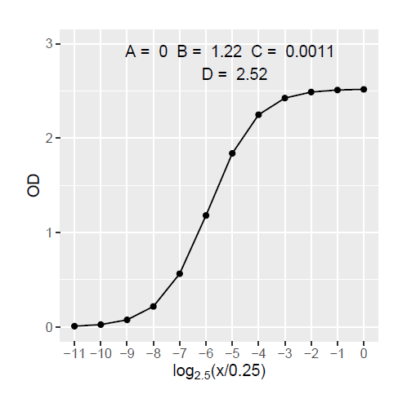
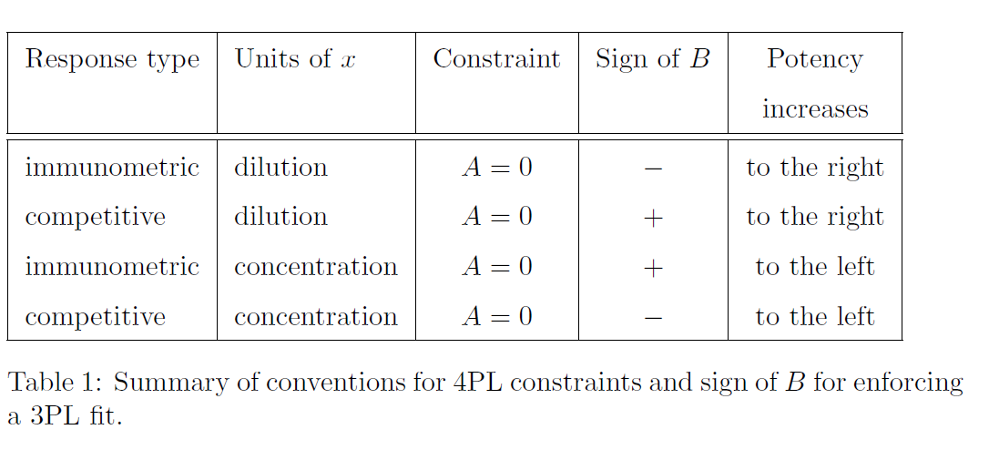
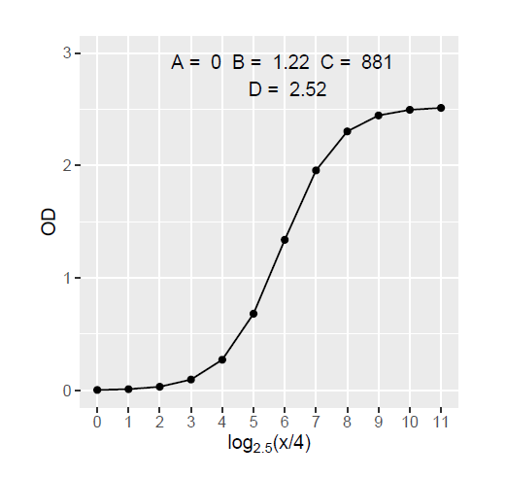
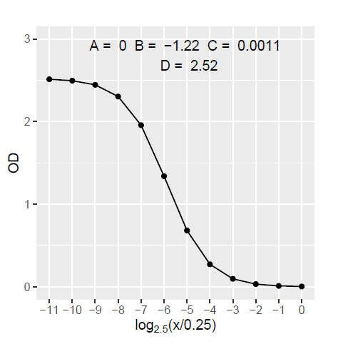
Dilution units
Concentration units
Immunometric ELISA
Competitive ELISA
Tong, C. and Vendettuoli, M. (2017) USDA APHIS STATWI0005.01 - Logistic Curve Parameterizations in Commercial Software. https://www.aphis.usda.gov/animal_health/vet_biologics/publications/STATWI0005.pdf

Slide 15
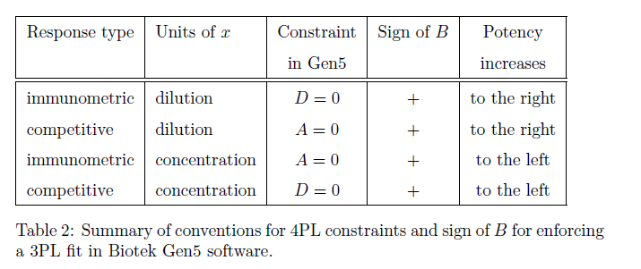
USDA APHIS Center for Veterinary Biologics’ internal practice
1997 - present
Lower asymptote
Software manufacturer implementation
2006 - present
Tong, C. and Vendettuoli, M. (2017) USDA APHIS STATWI0005.01 - Logistic Curve Parameterizations in Commercial Software. https://www.aphis.usda.gov/animal_health/vet_biologics/publications/STATWI0005.pdf

Slide 16
Software Validation
out of scope (for this talk)
Validation and verification of data
Decision-making component of identifying requirements, risk assessment
Unit/regression/integration testing

Slide 17
Software validation as process
Define requirements
Define tests
Execute tests
Document observations
(repeat)

Slide 18
Software validation as process
Define requirements
Define tests
Execute tests
Document observations
Fit for purpose
Reproducibility
Effort

Slide 19
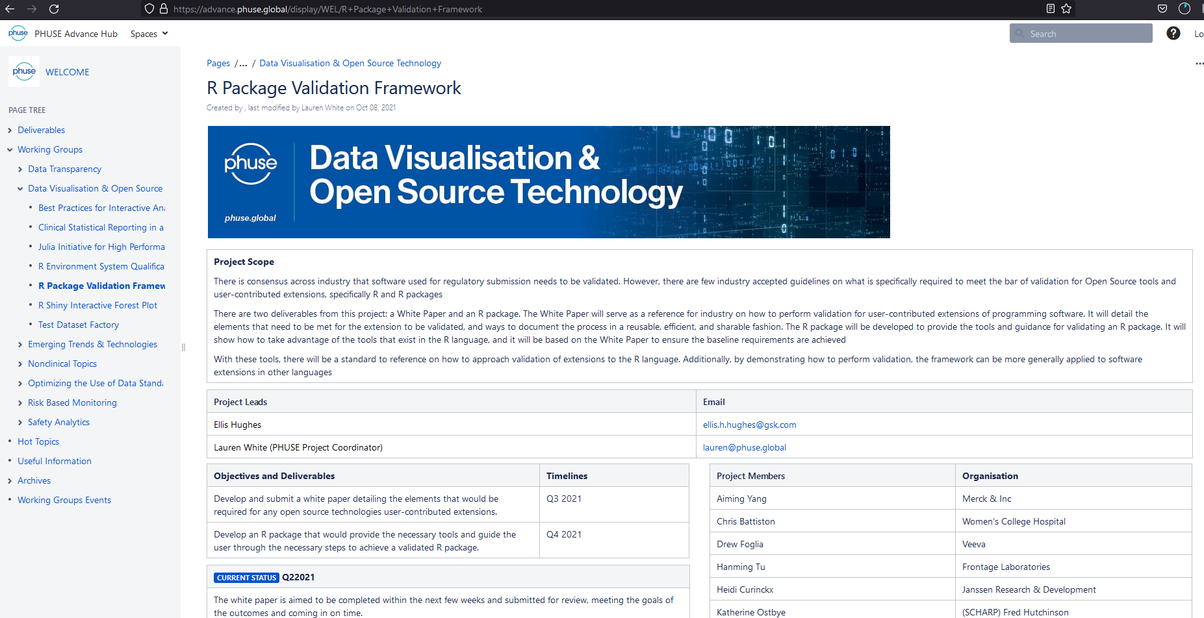
R Validation Framework
R Package Validation Framework
Structuring the process for R
Define elements of validation
Requirements
Test cases (optional)
Test code
Reports
Specify a common organization of validation elements
Process for evaluating the test code and generating reports
System for sharing of validated code and reports
Common approach for developers and useRs
https://advance.phuse.global/display/WEL/R+Package+Validation+Framework

Slide 20
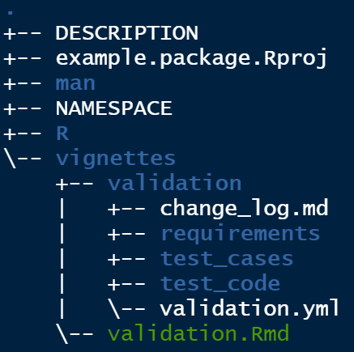

R Validation Framework
structuring the process for R
PACKAGE DEVELOPMENT
VALIDATION REPORT
REQUIREMENTS
GOALS OF PROJECT
RISK ASSESSMENT
VALIDATION ENVIRONMENT
AUTHORSHIP AND ROLES
REQUIREMENTS
TEST CASES
TEST CODE AND RESULTS
FUNCTIONS
DOCUMENTATION
roxygen2
rmarkdown
roxygen2
devtools
usethis
TEST CASES
TEST CODE
HOW PACKAGES MEET REQUIREMENTS
rmarkdown
testthat
roxygen2
TEST CASES IMPLEMENTED AS R SCRIPTS
execute code
roxygen2
rmarkdown
roxygen2
testthat
PHUSE (2021) R Package Validation Framework

Slide 21
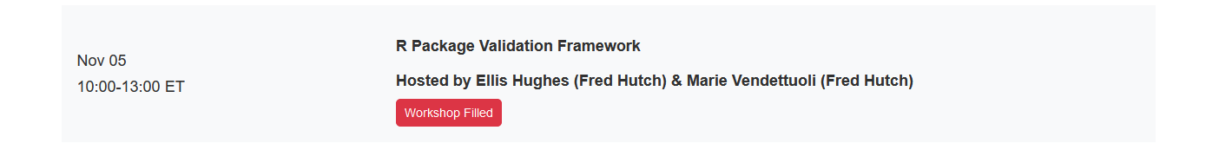
Intro to {valtools}
https://github.com/phuse-org/valtools

Slide 22
Intro to {valtools}
Start here!
Initiate framework and validation elements from templates
Manage report content
Execute validation in multiple modes
- Separate from development
From source code
At installation
For distribution
After installation
PHUSE (2021) R Package Validation Framework

Slide 23
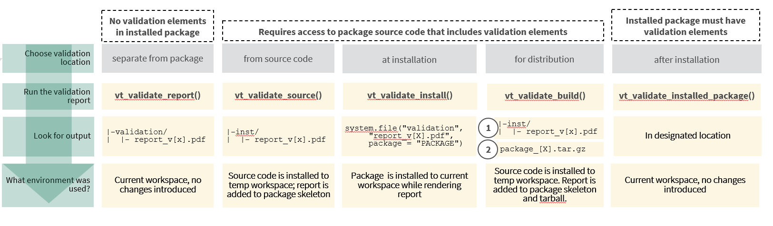
Intro to {valtools}
PHUSE (2021) R Package Validation Framework

Slide 24
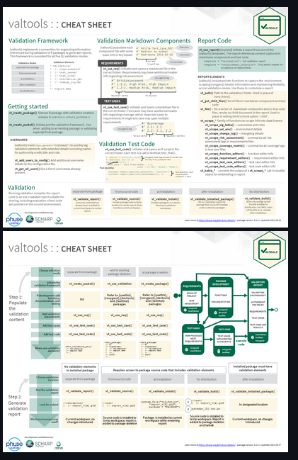
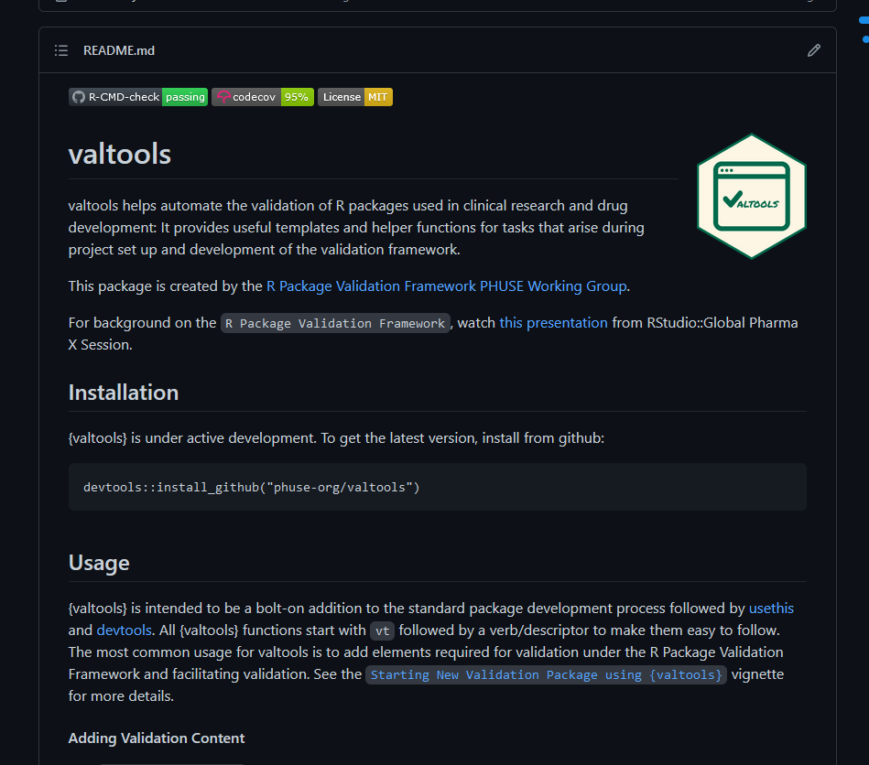
Intro to {valtools}
https://github.com/phuse-org/valtools

Slide 25
Performance Qualification (PQ) Testing
Checks that the system performs as expected under real-world conditions
Happens after installation/setup of system
Evaluates the whole system, not just individual components
May be repeated at specific intervals:
Periodic, e.g. daily, weekly
At startup
After a system change e.g. updating an R package

Slide 26
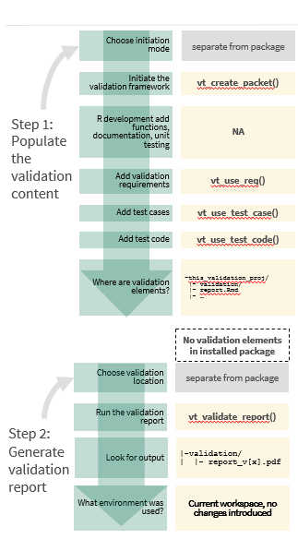
Performance Qualification (PQ) Testing
why {valtools} ?
Testing within an R environment
Re-executable and extensible
Similar to previous validation work

Slide 27
PQ testing @ SCHARP
Questions for consideration
What is the default state of the working environment? Is this expected?
Do we get the same results when switching environments, e.g. different servers or operating systems?
What custom options are we setting, specific to our organization?
For workflows that depend on functions from multiple packages, do we observe unexpected interaction?
How do we communicate expectations between stakeholder groups?
How does validation code evolve over time? Is this easily traceable?

Slide 28
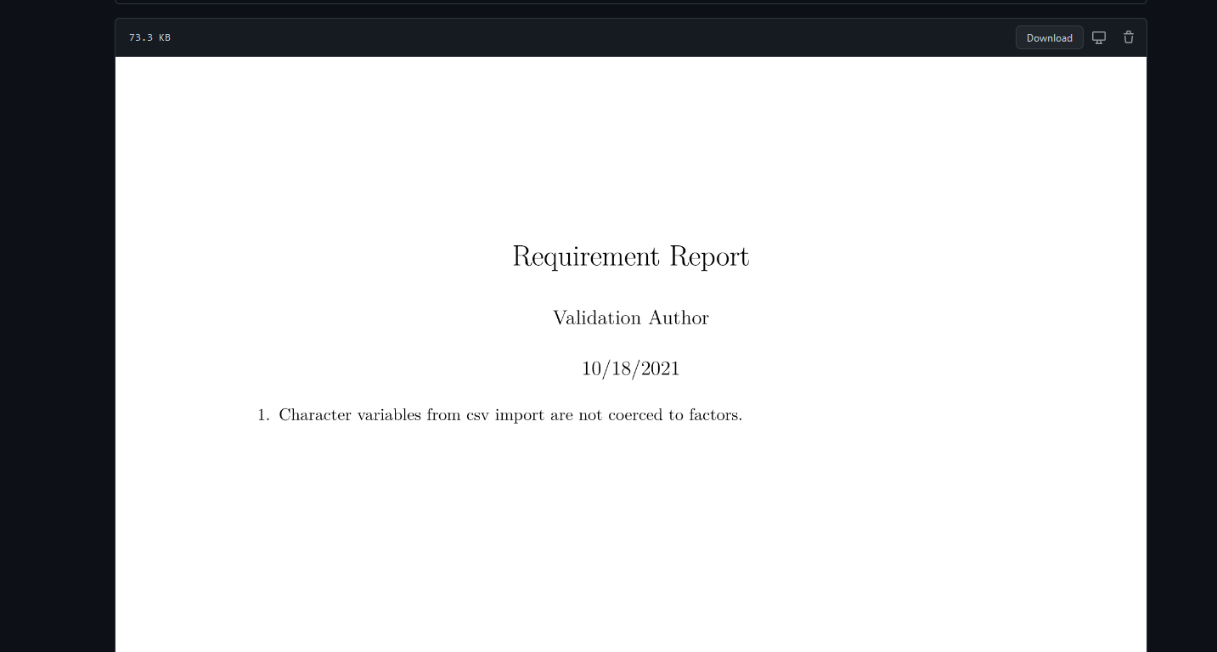
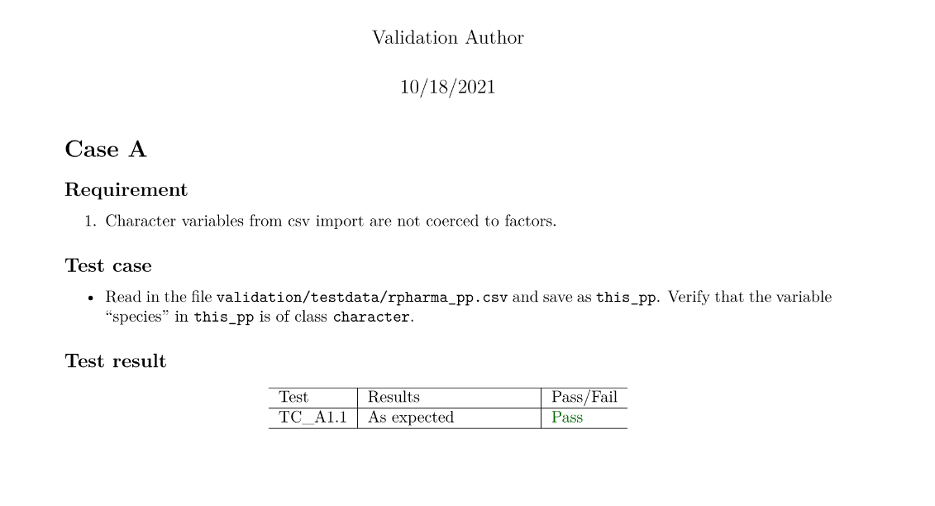
PQ testing @ SCHARP
How do we communicate expectations between stakeholder groups?
Requirement report
Validation report

Slide 29
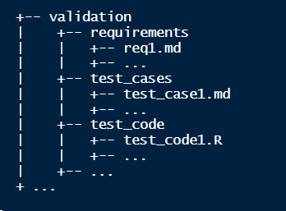
PQ testing @ SCHARP
Keep it DRY
Requirement report
Validation report

Slide 30
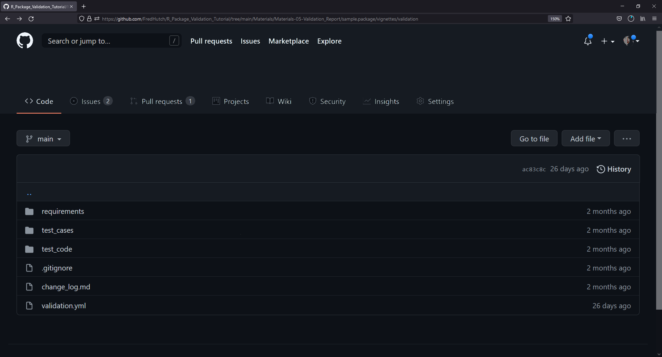
PQ testing @ SCHARP
How does validation code evolve over time?
Notes:
Obstacles – developers vs. other stakeholders

Slide 31
Decisions that {valtools} cannot help with …
What is the default state of the working environment? Is this expected?
Do we get the same results when switching environments, e.g. different servers or operating systems?
What custom options are we setting, specific to our organization?
For workflows that depend on functions from multiple packages, do we observe unexpected interaction?
Requirement report

Slide 32
Why we like {valtools} at SCHARP
Modular development of requirements, test cases, test code, reports
Easy to customize and reuse validation elements
Extensibility/flexibility as needs change
Parallelization between decision-making and testing phases
Accessible materials for developers and non-developers
Bonus: single paradigm for system validation & package development validation

Slide 33
Marie Vendettuoli // Senior Statistical Programmer // mvendett@scharp.org
mariev

